Slide 1
Micro Data Center using Raspberry Pi for Video Streaming
Research proposal
PAUL vELTHUIS

Slide 2
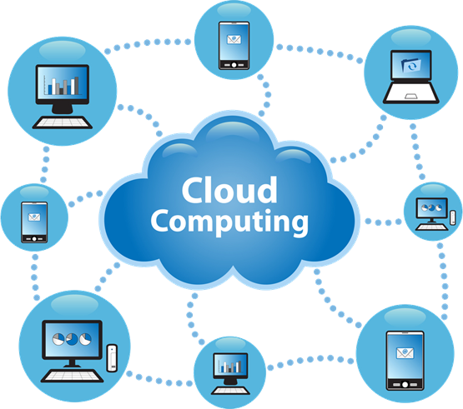
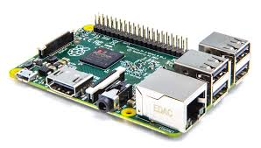
State of the Art
Cloud computing
Data servers
More lightweight portable device
Power consumption
Raspberry Pi
Small device
Low power usage
No cooling
Small tasks

Slide 3



Problem Statement
A Lot of data bandwidth usage
Inefficient algorithms
Servers require to much power

Slide 4
Research Question
How well does the Raspberry Pi perform in micro scale data centers with video streaming?
Sub Questions

Slide 5
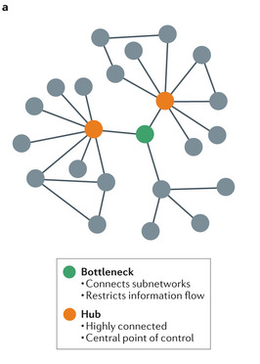
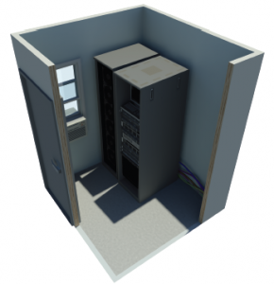
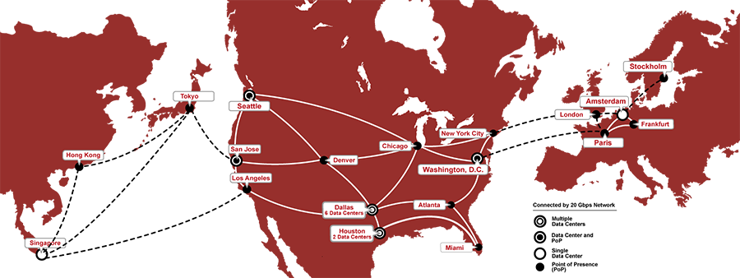
What are micro scale data centers with video streaming and why are they used?
Less expensive
Can be placed behind bottleneck
Space
Cooling

Slide 6
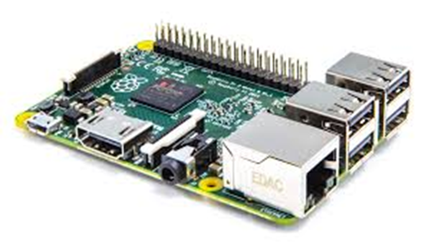


Is the Raspberry Pi feasible for video streaming?
Streaming over HTTP
Throughput (I/O and internet consumption)

Slide 7

How to fit the Raspberry Pi's into a data center considering cooling, space allocation and power?
Previous projects
Power
Cooling
Location

Slide 8
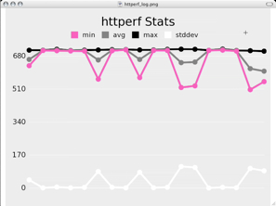

What setup does a Raspberry Pi cloud with video streaming require?
Operating system
Testing environment
Software
Previous projects

Slide 9
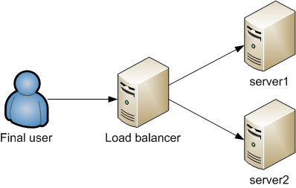
How is availability in a Raspberry Pi cluster with video streaming affected by various load balancing techniques?
Throughput
Availability
Different techniques

Slide 10

Planning
April-May: Building Test environment,
Every week answer one research question
Week 20: Check for coherency and make conclusion
Week 21: Make abstract and finalize paper
Week 23: Deadline paper
Week 24-25: Make presentation
Week 26: Conference

Slide 11
Questions?

